Slide 1

Hello world web application – Cloud setup
Villvay systems pvt ltd

Slide 2
Considerations for architecture
It is resilient and single node failure does not affect end users.
Application can be scaled, preferably automatically, to handle increased loads.
Infrastructure and required services provisioning as well as application deployment is automated and can be triggered with a click of a button or a command in a terminal.
Automate provisioning and destruction of this setup in AWS, you may use a suitable CI/CD process and a suitable code repository
When an authorized person uploads a new file with his name as content to the S3 bucket, file should be automatically downloaded to the server and the webpage should be updated based on the content of the file.
There should be sufficient level of error logging and/or audit trails established as part of the implementation
Ensure there is some level of security implemented for the files that gets stored in S3 Bucket and limit access only to the web application. Explain your rationale for this implementation.

Slide 3
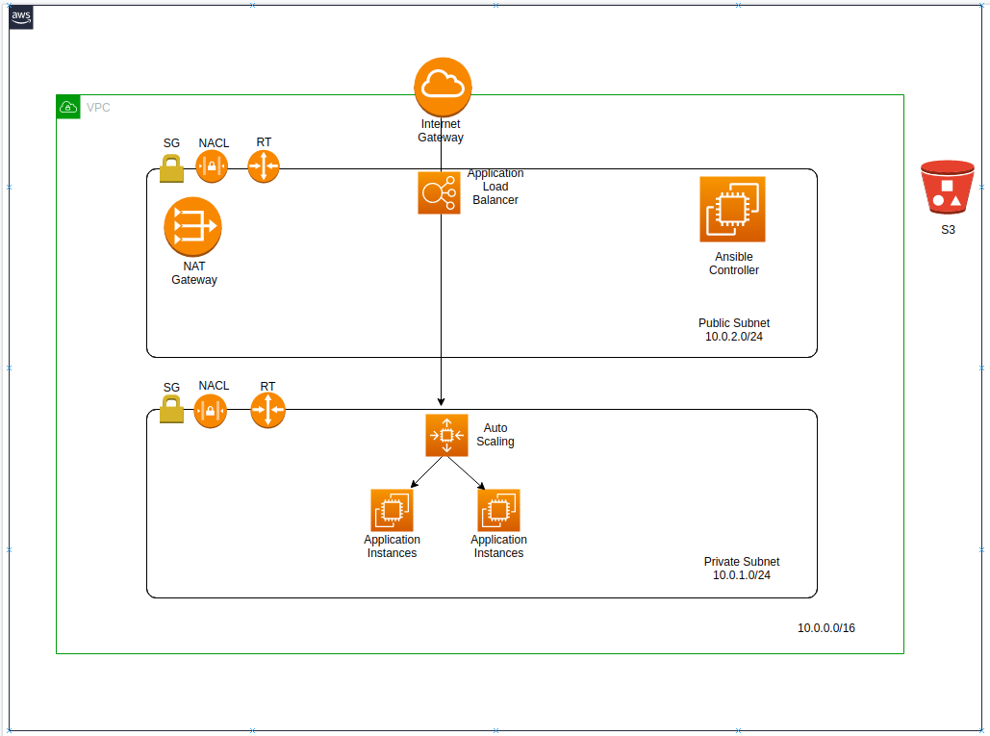
Proposed architecture

Slide 4
Security posture and improvements
Application running in private subnet without a public ip . This minimise risk of getting access to the system by unauthorized parties.
Backend servers only allow incoming from ELB and Bastion Host minimizing risk of getting direct attack to the instances.
There is no mechanism to prevent attacks such as ddos for this system Use WAF/Shield services.
AMI used in the solution is not hardened. Harden Golder image AMI.
No SSL certificate used for this implementation exposing vulnerability. make sure end to end communication encrypted via SSL.
EBS volumes where data resides are not encrypted. use encryption to protect data at rest.
Analyze iam role used for s3 access. make necessary changes according to the level of access required.
s3 access via public internet to sync content. use VPC endpoints to access s3 via AWS network.

Slide 5
Cost analysis and optimization
Use a proper tagging mechanism to segregate resources.
Enable AWS cost explorer to analyze usage pattern and cost trends.
Use AWS budgets to create alerts for budget thresholds defined.
Use horizontal scaling over Vertical scaling for resources, which allows to start with minimum specification.
Analyze workload and commit to reserved instances to bring down pricing.
analyze resource utilization and make plans to shut down unnecessary resources introduced to the account.

